Slide 1

Your Gateway to Compliance Solutions
Jill Marver on behalf of
Ruby Yepez, Jeremy Reefe & Ray Mendoza
Notes:
I’m today’s spokesperson …speaking on behalf of my counterparts:
Adrian Salas
Javier Mariscal and Gary Shushnar
Dipo

Slide 2

CEC & IOUs
Architects & Designers
We exist to…
Make it faster and easier for YOU to comply with Title 24, Part 6 and Title 20
We want to…
Understand your workflow and what’s in your way
Work with YOU and code experts to develop solutions to your code compliance hurdles
Gain the CEC’s blessing and launch Tools, Training and Resources that meet your needs
Energy Consultants
Manufacturers
Test Labs
Plans Examiners
Builders & Contractors
Building Inspectors & HERS Raters
Distributors
Home & Building Owners
Retailers

Slide 3

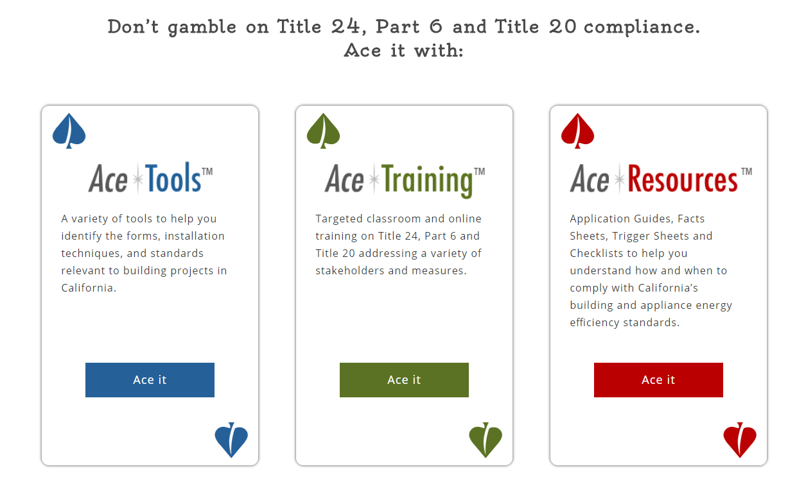

Why Tools, Training & Resources?
Make it faster, easier
Automate it
Teach me what I need to know
Practice what I need to do
Give me a cheat sheet
Help me quickly guide others
Streamline my workflow

Slide 4
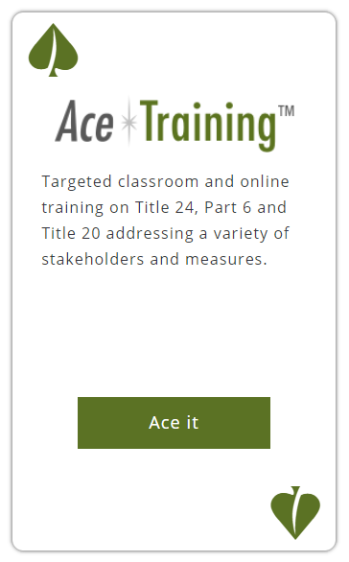
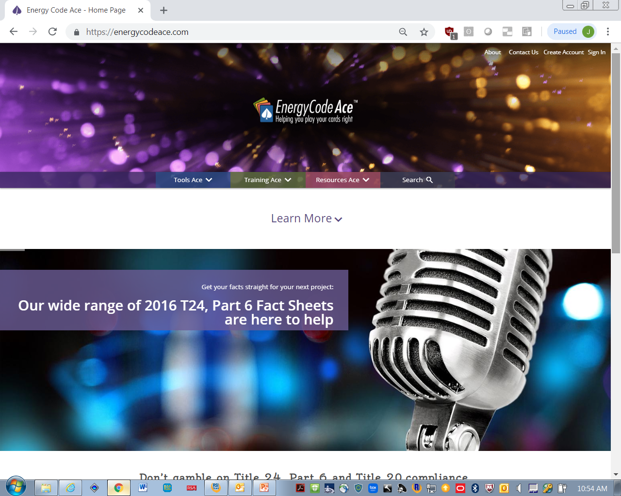




Learn the essentials & practice with an expert
Get training when, where & how you need it
Focus on specific job tasks Standards Essentials for…
Various formats | Live with an instructor – Your classroom or ours Live with an instructor – Adobe Connect or YouTube On your own – Through our web site when and where you want
Less talking, more doing | Don’t expect to just listen (or read) We don’t spray and pray You get to practice doing your job
We come to you & give you CEUs | Invite us ICC, AIA

Slide 5
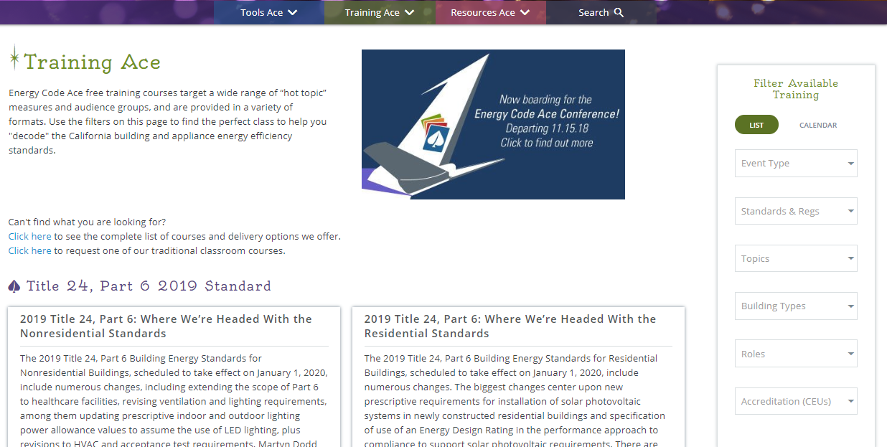
Learn the essentials & practice with an expert
Get training when, where and how you need it
Let the filters guide you

Slide 6
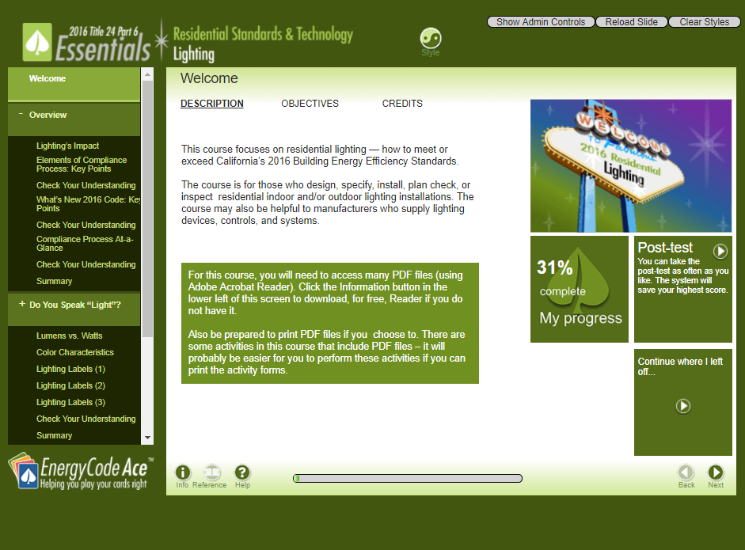
On-Line Self Studies
Your own time and place

Slide 7
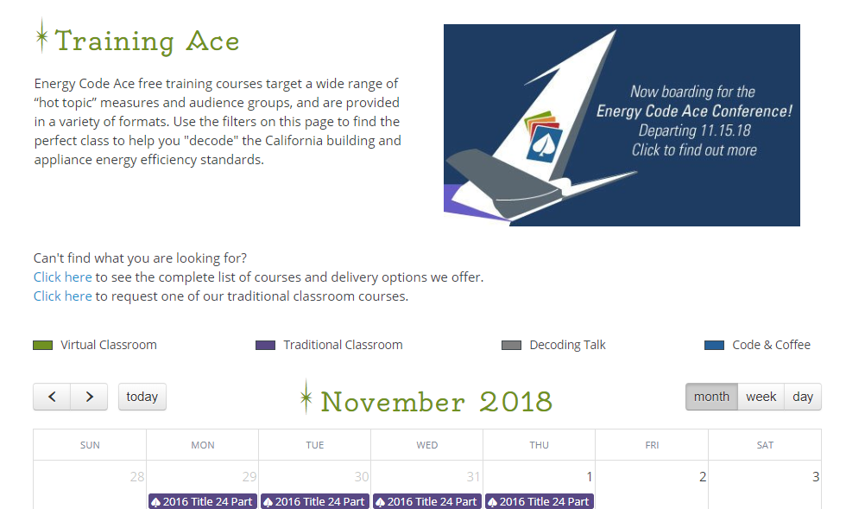
Click to request a course

Slide 8
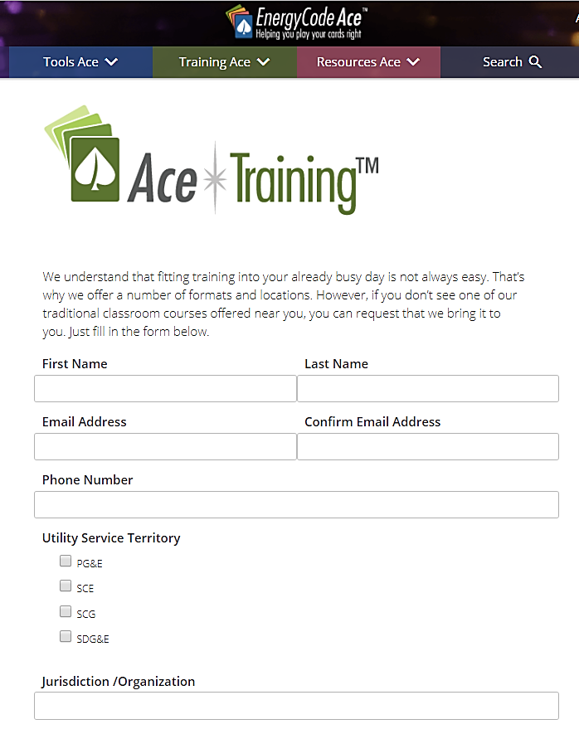

  Offered live in traditional classroom – yours or ours
  Offered live in virtual classroom
Focused on your work tasks
Some lecture, lots of practice, coaching
  CEUs for ICC and AIA
  Request a class:
    EnergyCodeAce.com/content/training-request
EnergyCodeAce.com/Training

Slide 9
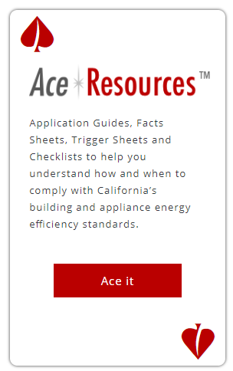
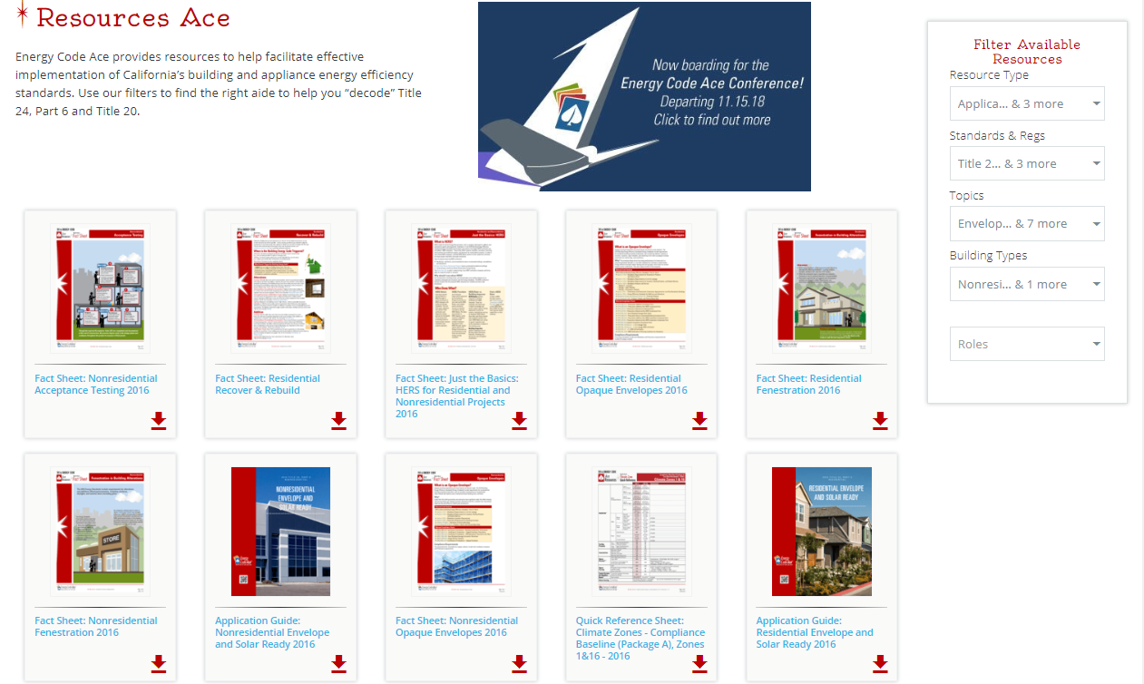

Get quick answers - Guide someone else - Streamline your workflow

Slide 10
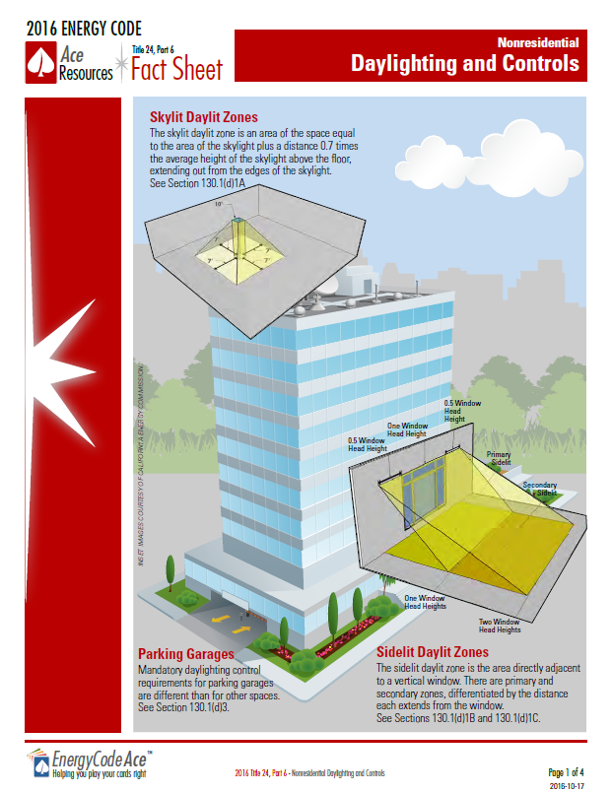
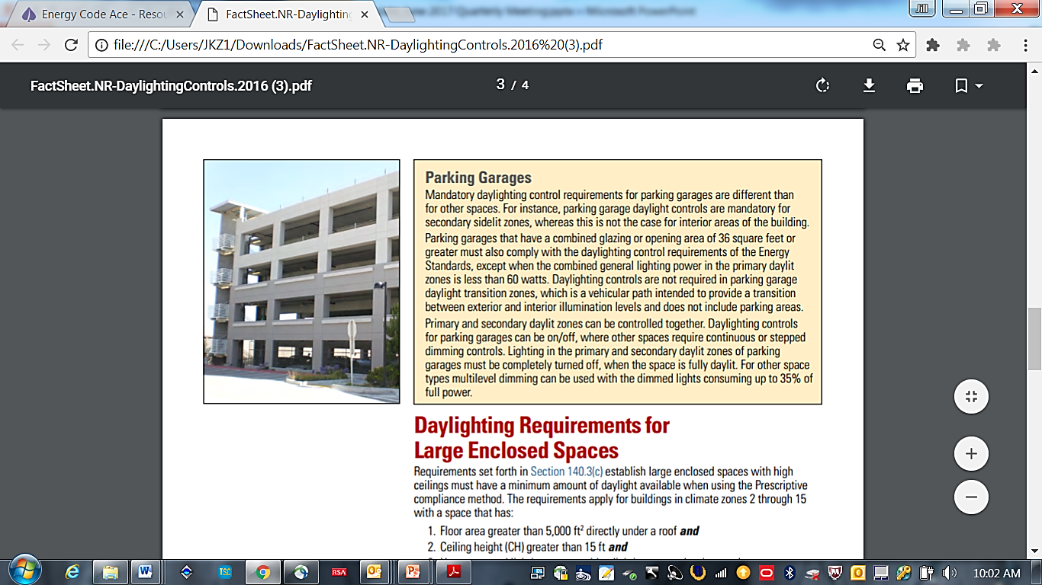
Fact Sheets &
Infographics
Simple illustrations
Hyperlinks to relevant code sections and forms
Click here
EnergyCodeAce.com/resources

Slide 11
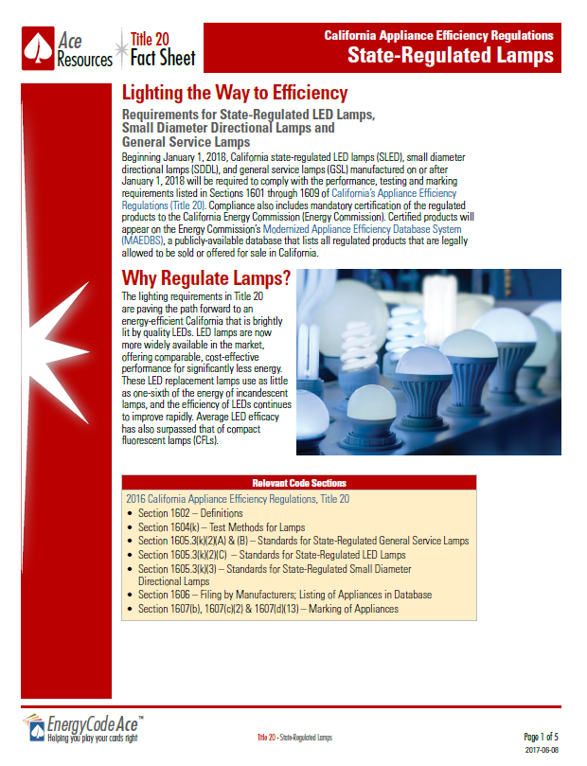
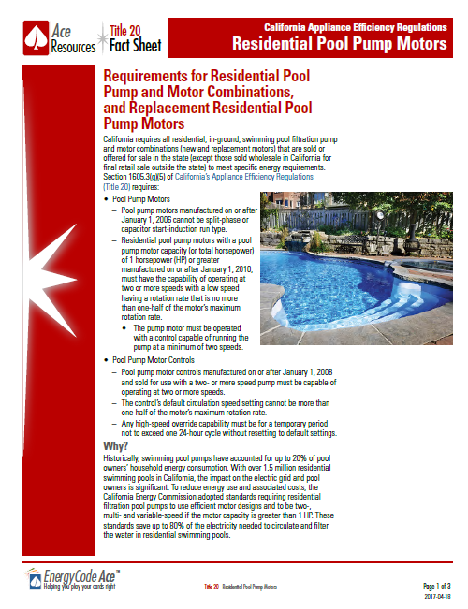
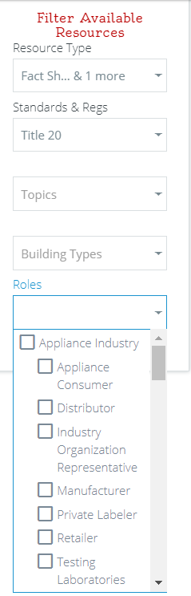
Our library includes T20 too
Title 20 too
EnergyCodeAce.com/resources

Slide 12
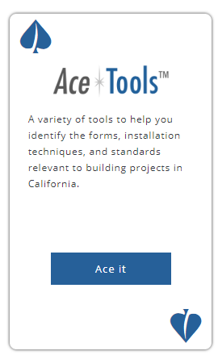
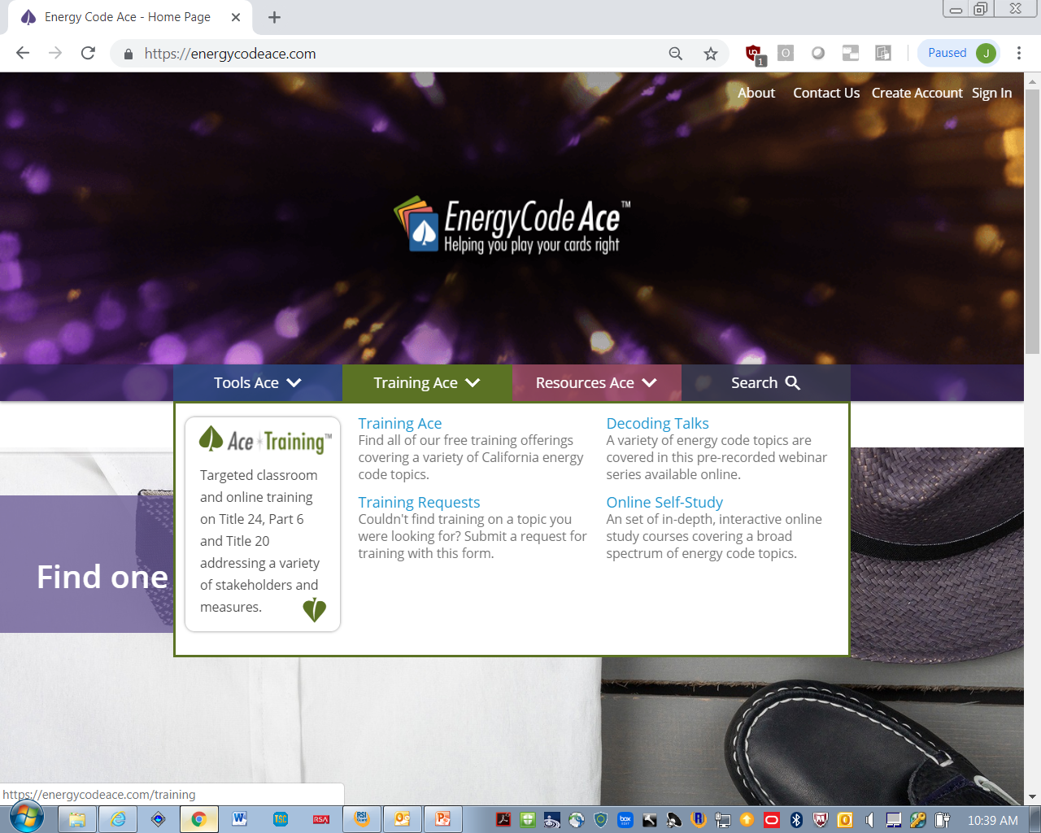
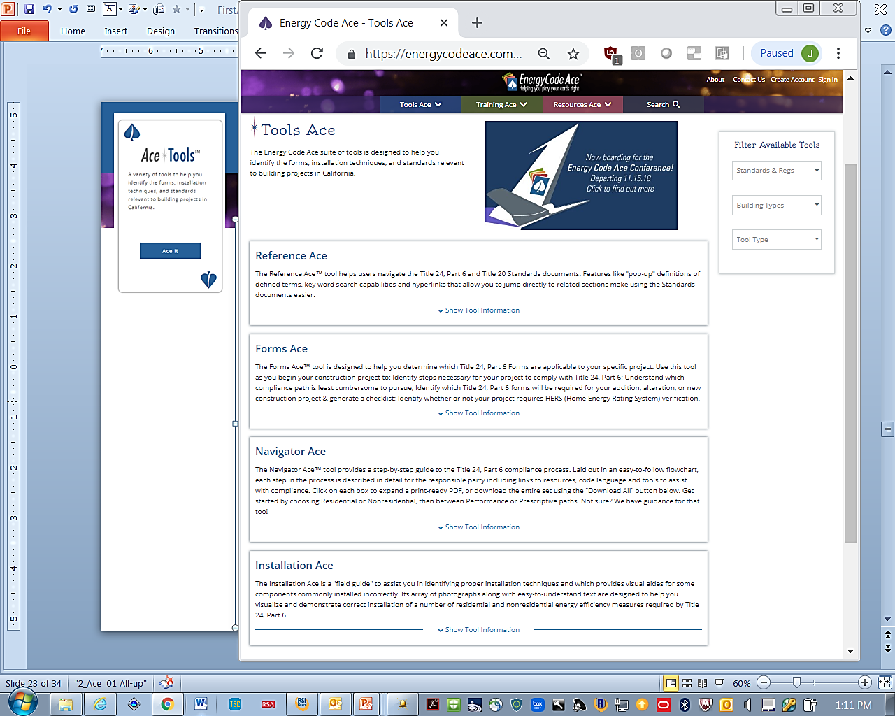
Make it faster & easier
Bake in the logic & automate
Timeline Ace
Q&Ace

Slide 13
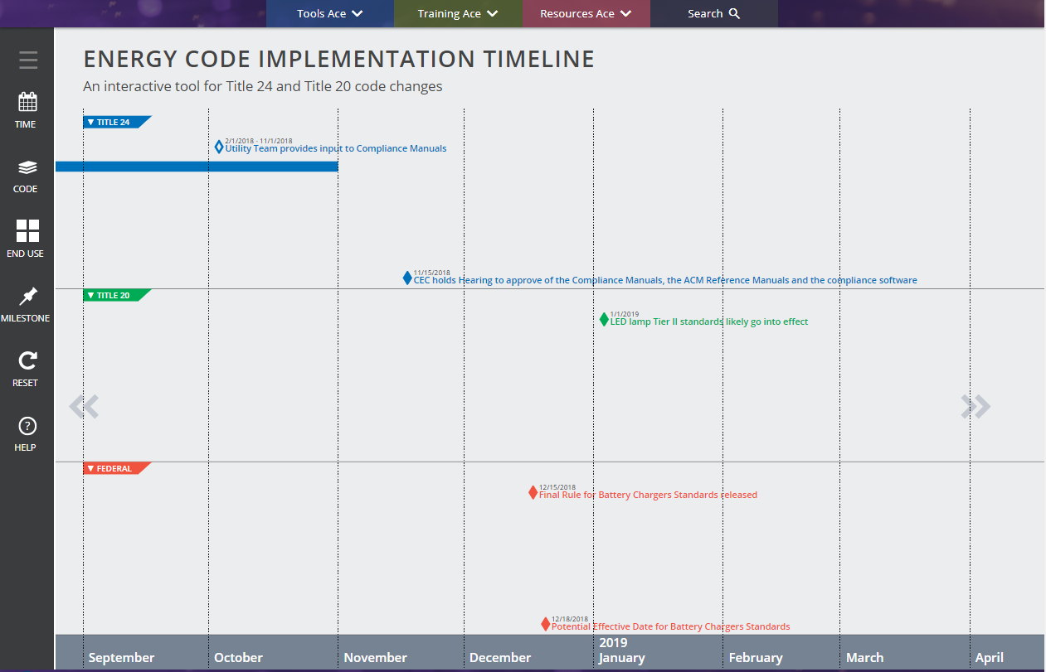
Timeline Ace
Title 24
Stakeholder Workshops
Title 20
Effective dates for specific measures covered by CA
Federal
Effective dates for specific measures covered by Federal Govt
Notes:
YW

Slide 14
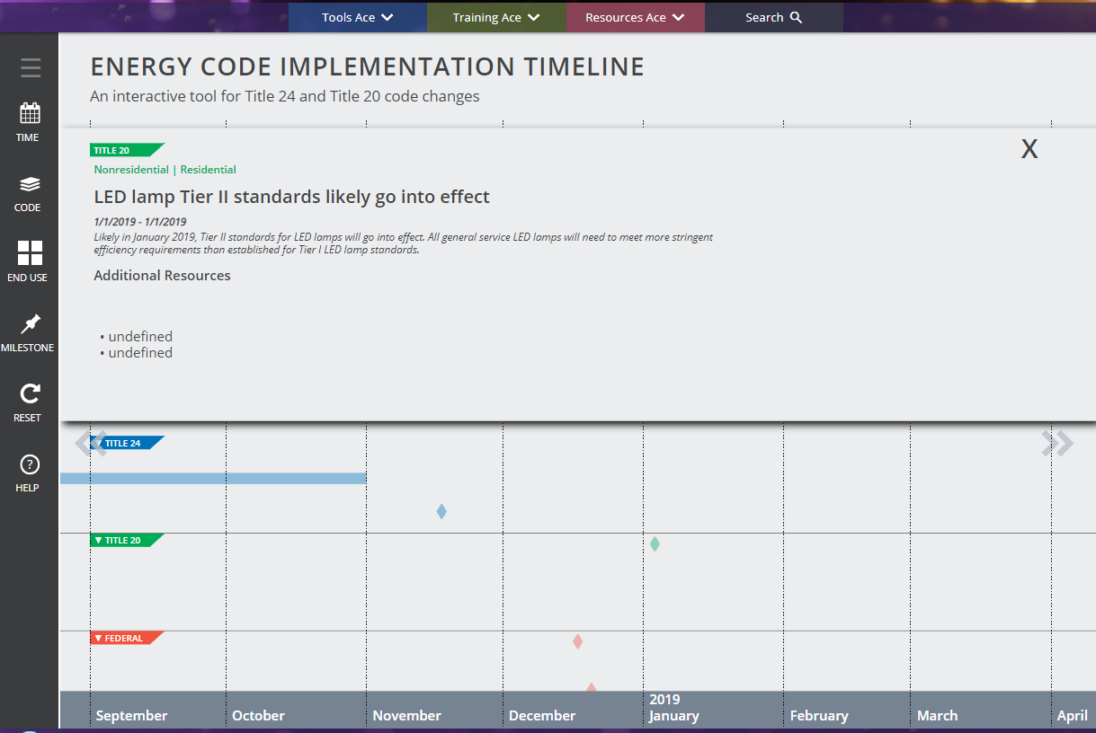
Timeline Ace
Hover for details
Notes:
YW

Slide 15
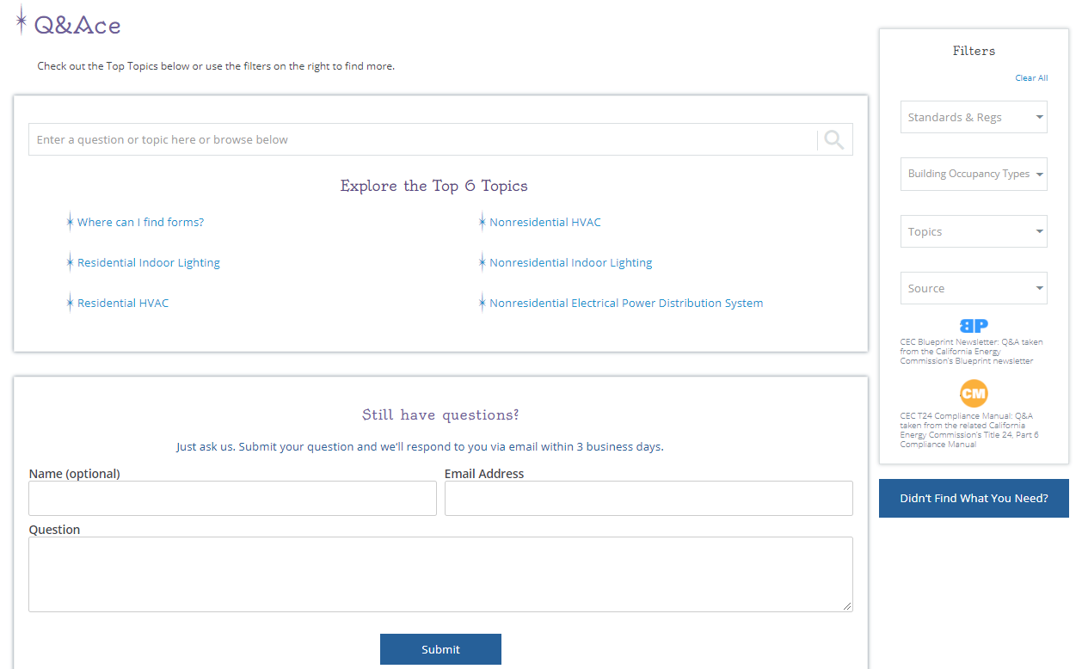
Q&Ace
Top topics populated for easy access
Enter a question or topic
Ask and Expert
Notes:
YW

Slide 16


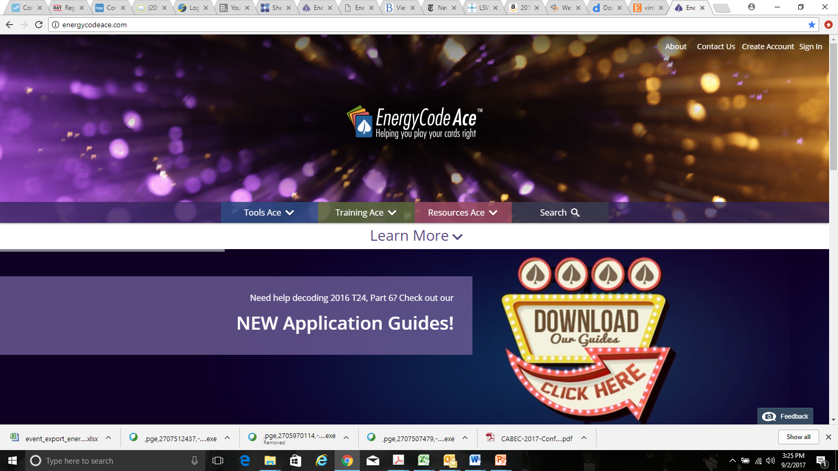

Problem
&
Solution
&

Slide 17
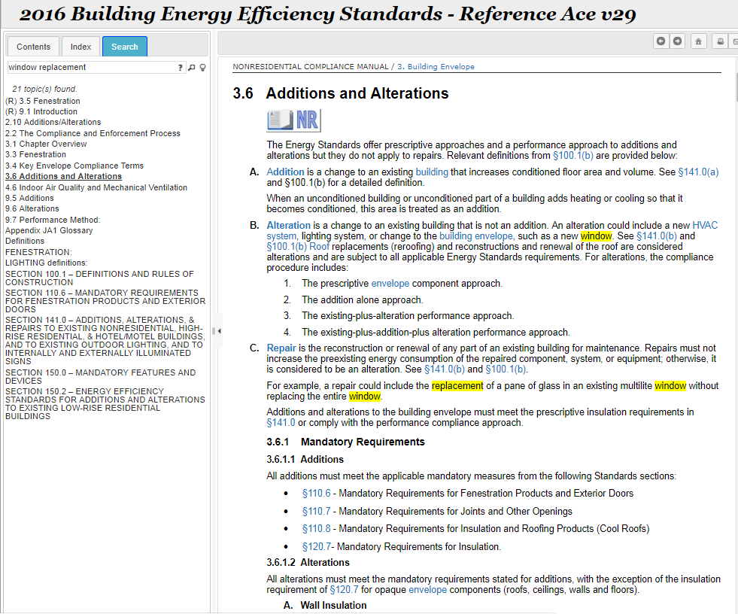
Reference Ace
Search for key terms
All instances & relevant hyperlinks appear
EnergyCodeAce.com/tools
Notes:
YW

Slide 18
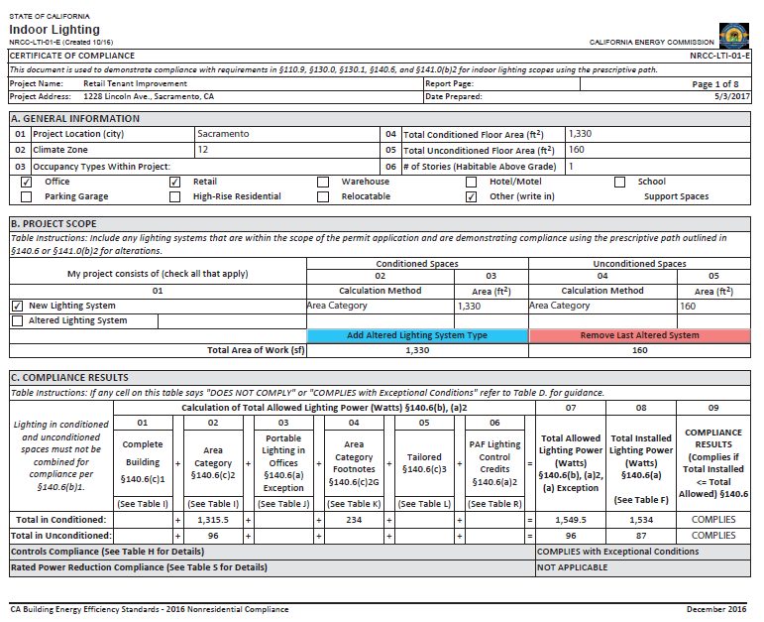
Dynamic Forms
#1 Complaint –
Too many forms and too many pages!
Partnered with CEC and industry to develop a new form:
Leads you through the compliance process
Presents only the pages necessary for your project
Calculates allowed LPD
Minimizes number of signature pages
EnergyCodeAce.com/tools

Slide 19

“Quit nibbling around the edges.”

Slide 20
#1 Request: “Turbo Tax it!”
Energy Code Ace JetPack
Our goal: Automate phases of the compliance process…starting with NonRes
 | Which compliance path is best: Prescriptive or Performance? If Prescriptive: Guide me through the compliance process – and verify along the way Help me specify compliant products Help me complete and print the appropriate forms Enable me to put my forms on the plans and share my project In essence, JetPack serves as a virtual Energy Consultant
 | Provide me with accurate, complete, official compliance forms from the start Enable me to quickly compare the forms with the plans and code requirements Automatically generate plan check comments JetPack makes plan check “Fast and easy.”
 | Provide me with a product portal that helps me identify compliant products Give me the ability to easily revise forms to reflect substitutions from the job site JetPack simplifies contractor’s work on the jobsite and facilitates substitutions
 | Help me use my time on the job site effectively Reduce the amount of time spent finding and reviewing forms Help ensure the forms on site reflect any substitutions JetPack eliminates forms frustration and verifies compliance in the field
20

Slide 21
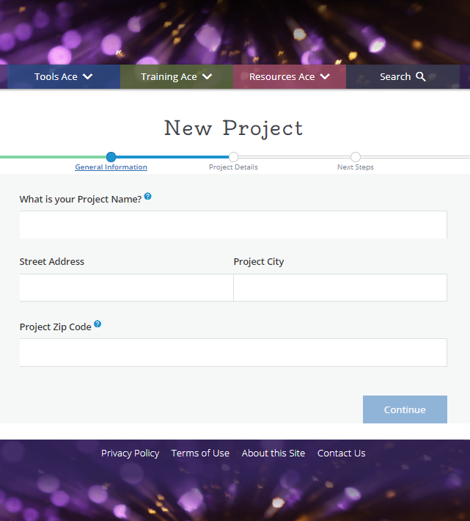
Make way for the
Energy Code Ace JetPack
1st Phase
Builds on logic behind dynamic forms
Moves beyond Livecycle limitations
Reduces cognitive load and time
Provides “help layers”
Verifies compliance before permit application
Provides official Nonres Prescriptive forms
  Lighting coming first

Slide 22
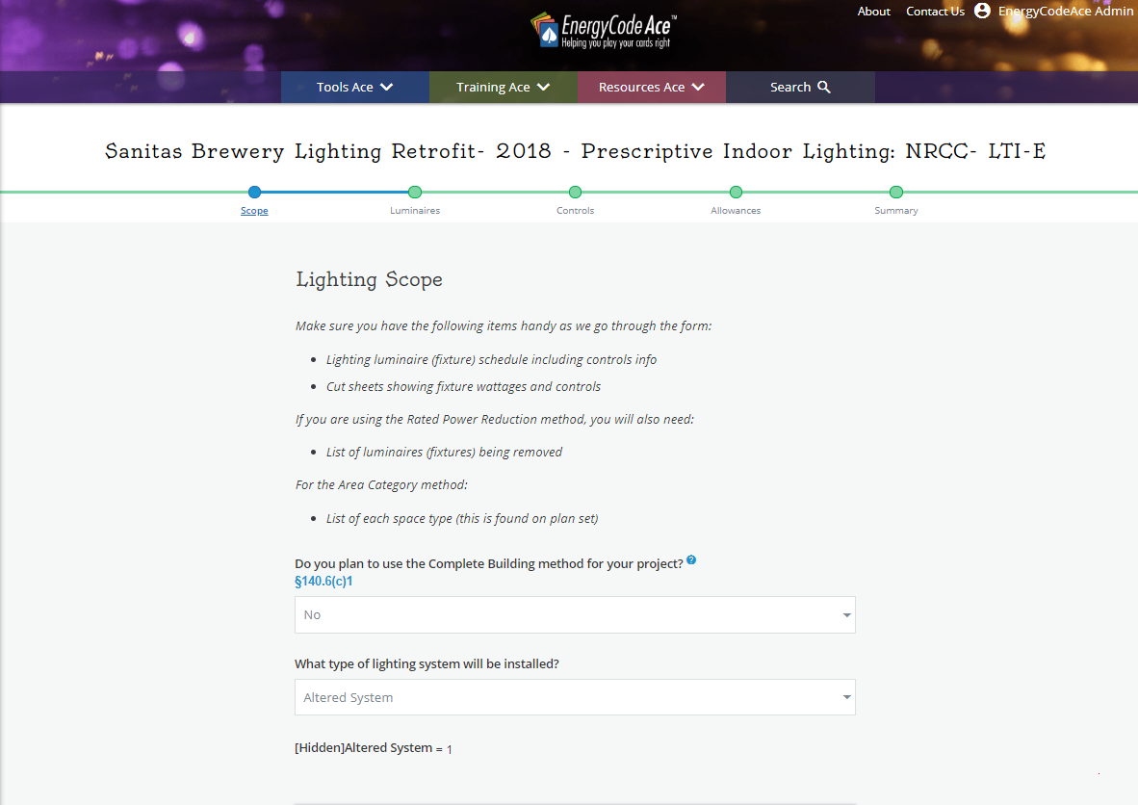
Users are encouraged to gather pertinent info prior to diving in

Slide 23
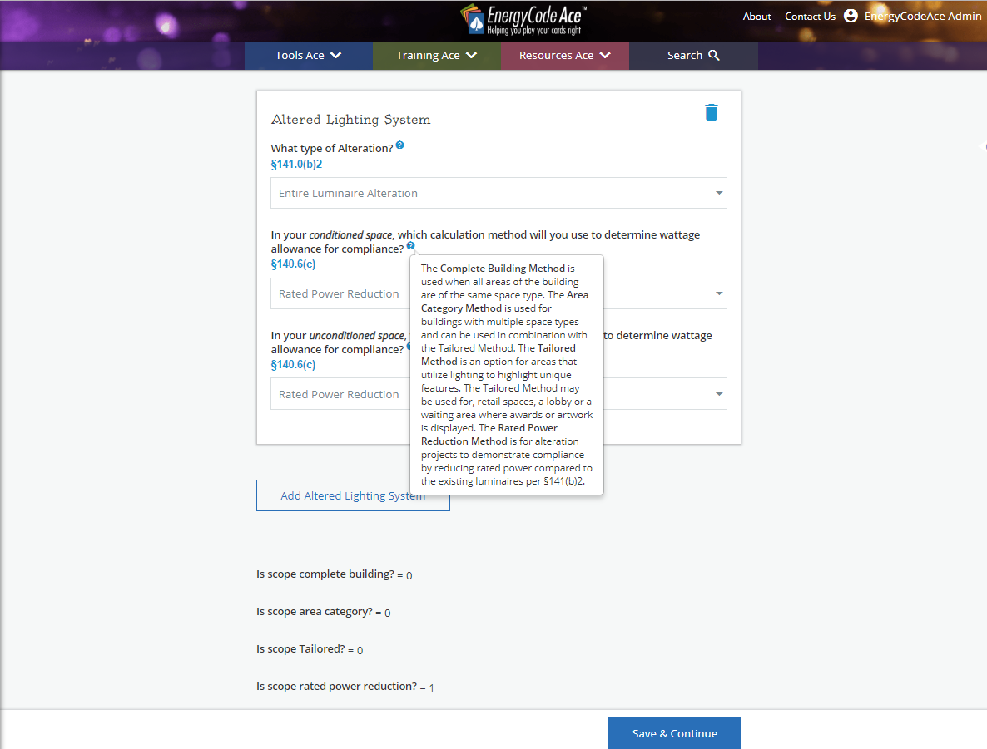
Hover over blue buttons for help

Slide 24
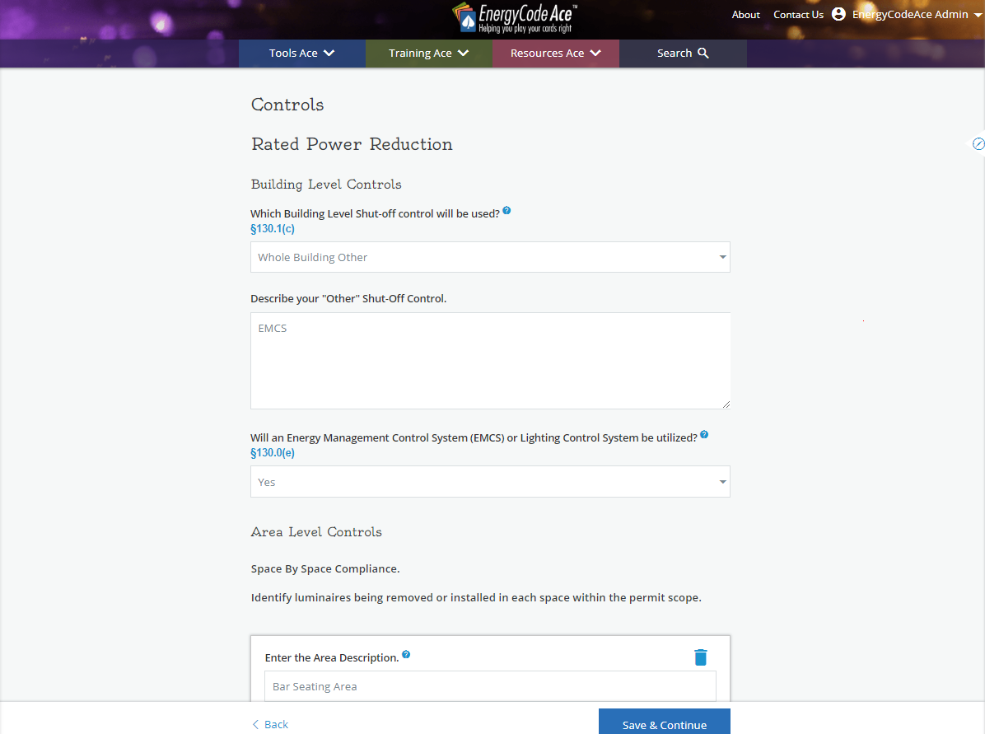
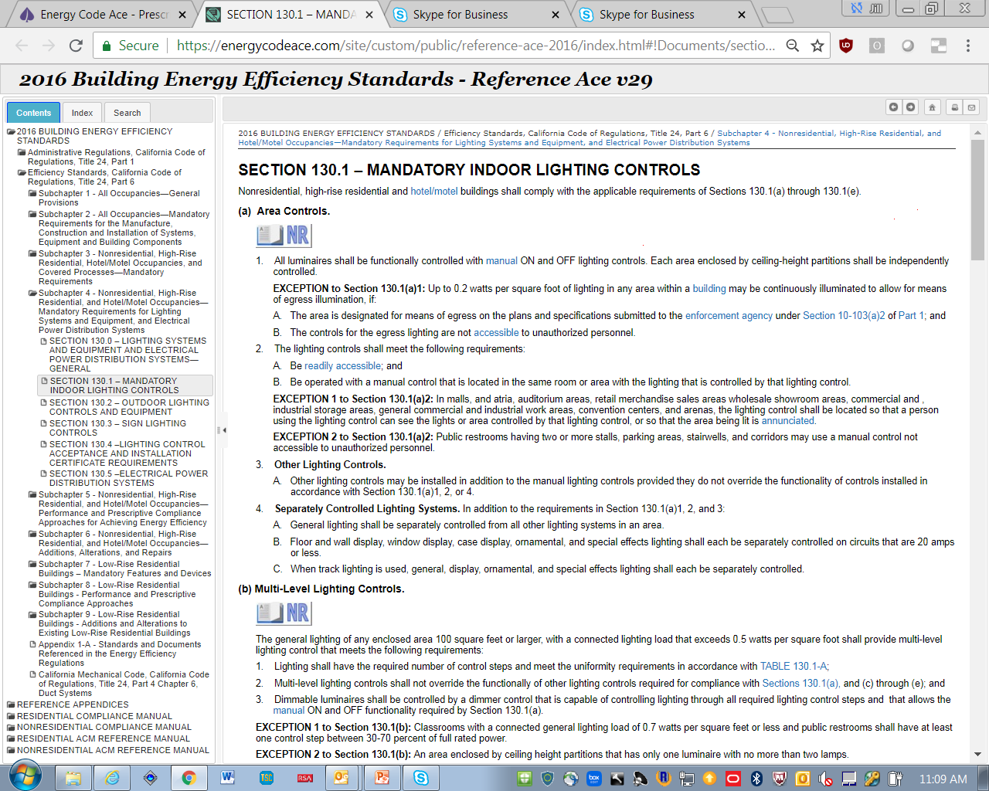
Click on blue code sections and link to Reference Ace

Slide 25
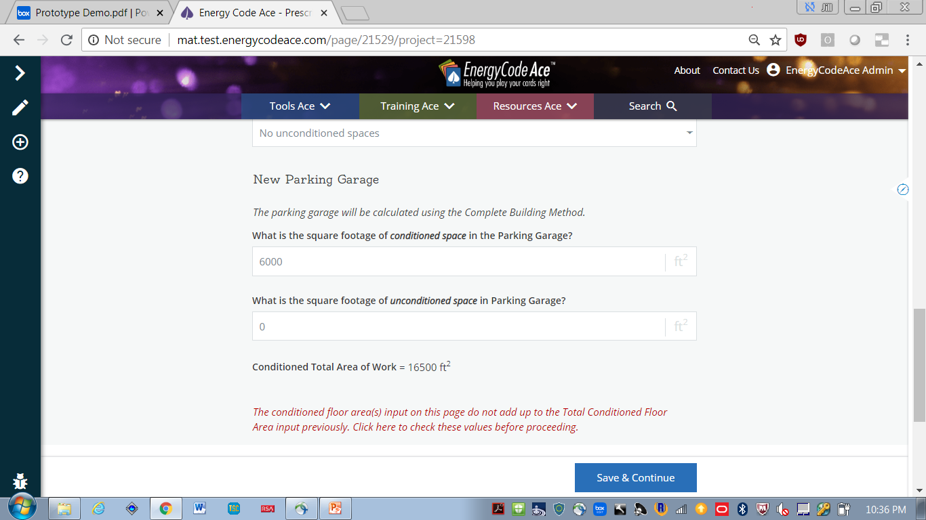
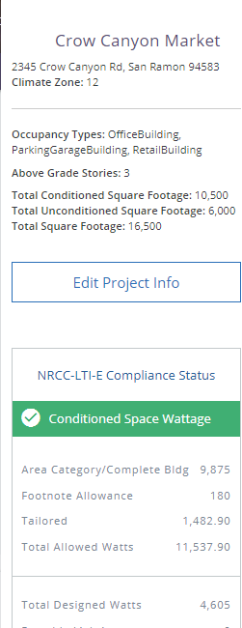
Provides opportunity to edit along the way

Slide 26
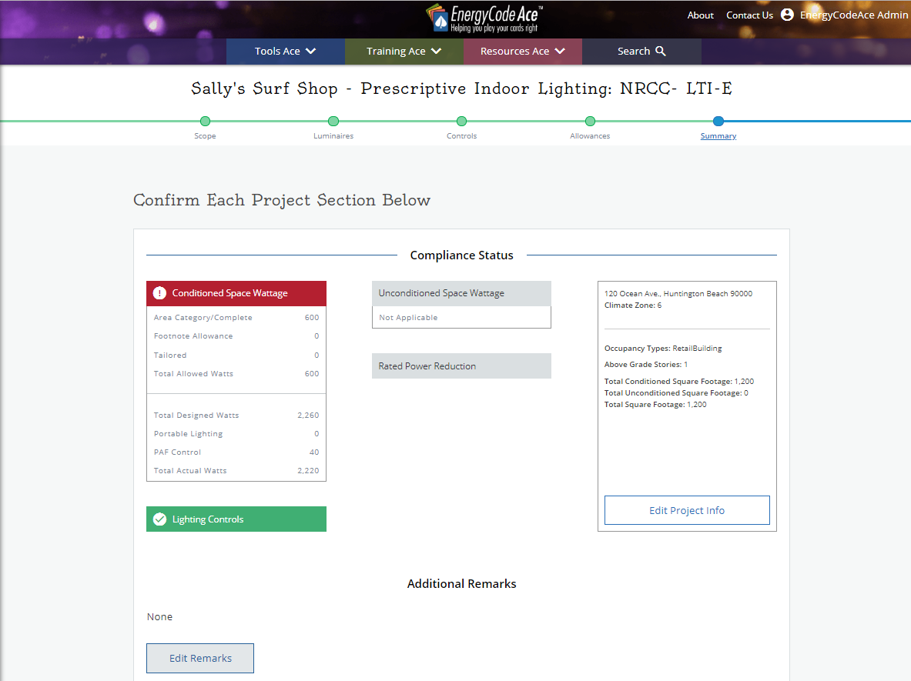
Summary screens to check your work along the way

Slide 27
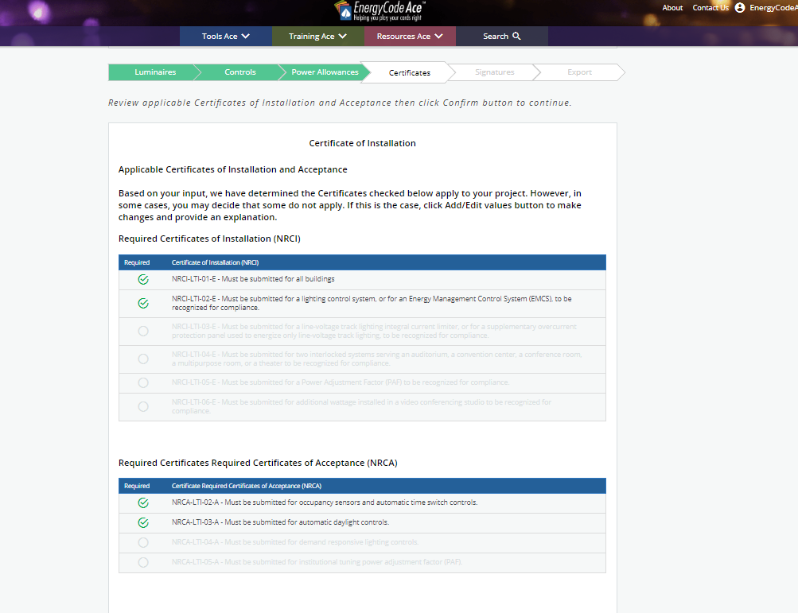
Lists the forms the construction team will complete
Notes:
Features:
This page uses data inputs to indicate when Certificates of Installation (NRCI) and Certificates of Acceptance (NRCA) forms are triggered for a project, which are used in the field to verify correct installation and performance. We heard from users that designers often do not know which NRCI or NRCA forms may apply, and are not able to specify them for the contractor and installers. This list alerts the construction team of which forms they will need to complete.

Slide 28
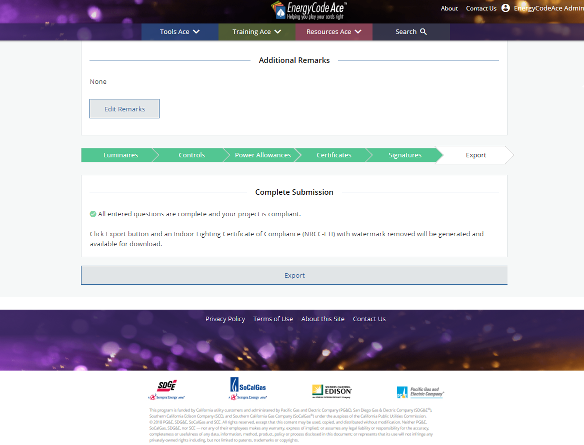
Indicates when project is compliant
Generates CEC approved form

Slide 29
And Now It’s Time For Some Sli.do Fun!

Slide 30
L
C
O
E
M
W
E
Iterate
What’s in your way?
Listen
Let’s create a prototype &
test it
Iterate
Launch!
Write to me:
Jill.Marver@pge.com

