Slide 1

California Energy Commission
Outreach & Education Tools and Resources
Notes:
I’m today’s spokesperson …speaking on behalf of my counterparts:
Adrian Salas
Javier Mariscal and Gary Shushnar
Dipo

Slide 2
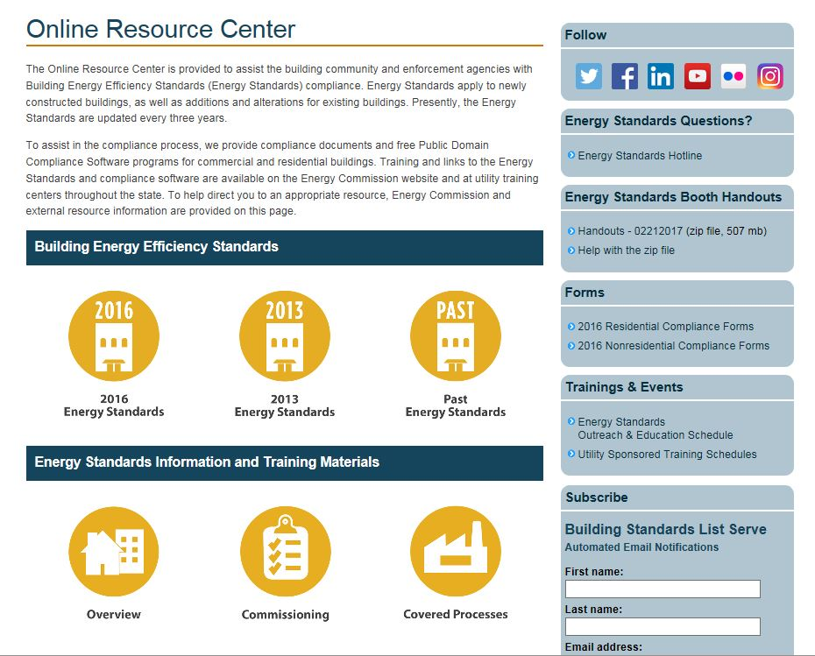
Online Resource Center (ORC)
www.energy.ca.gov/title24/orc/

Slide 3
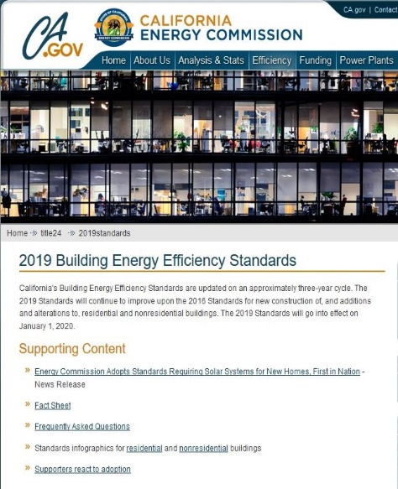
2019 Energy Standards Documents
Rulemaking Documents
  Revised Energy Code
  Reference Appendices
  Final Statement of Reasons (FSOR)
  Workshop presentations
https://www.energy.ca.gov/title24/2019standards/rulemaking/documents/
Post Adoption Documents
Residential Compliance Manual
Nonresidential Compliance Manual
https://www.energy.ca.gov/title24/2019standards/post_adoption/

Slide 4

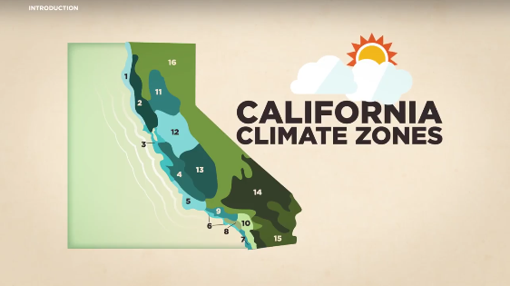
Energy Standards Videos
Energy Standards videos available on YouTube
33 Standards videos to date
Topics include
  Residential lighting
  Nonresidential lighting
  Residential HVAC
  Nonresidential HVAC
  More to come…
www.youtube.com/user/CalEnergyCommission/

Slide 5
Outreach & Education Schedule
Date | Location | Event | Activity | Additional Information
November 14, 2018 | Pasadena | Institute of Heating and Air Conditioning Industries - Trade Show | Exhibitor booth | http://www.ihaci.org/trade-show/
November 14, 2018 | Webinar | CABEC Brown Bag Webinar | Presentation - Energy Code for Townhomes (1 hour) | https://cabec.org/
November 15, 2018 | Marina | Monterey Bay Chapter International Code Council - Monthly Meeting | Agency Updates and Presentation | http://www.iccmontereybay.org/
November 15, 2018 | Downey | Energy Code Ace Annual Conference | Exhibitor booth and Presentation | https://energycodeace.com/conten t/conference
December 04, 2018 | Pleasant Hill | Diablo Valley College Class Presentation | Presentation - Energy Standards Basics
December 17, 2018 - December 20, 2018 | Anaheim | California Building Officials - Education Week: Anaheim | Exhibit Presentation 12/17 - Residential Envelope Presentation 12/18 - Nonresidential Lighting & Electrical | https://www.calbo.org/education/ edweek/

Slide 6
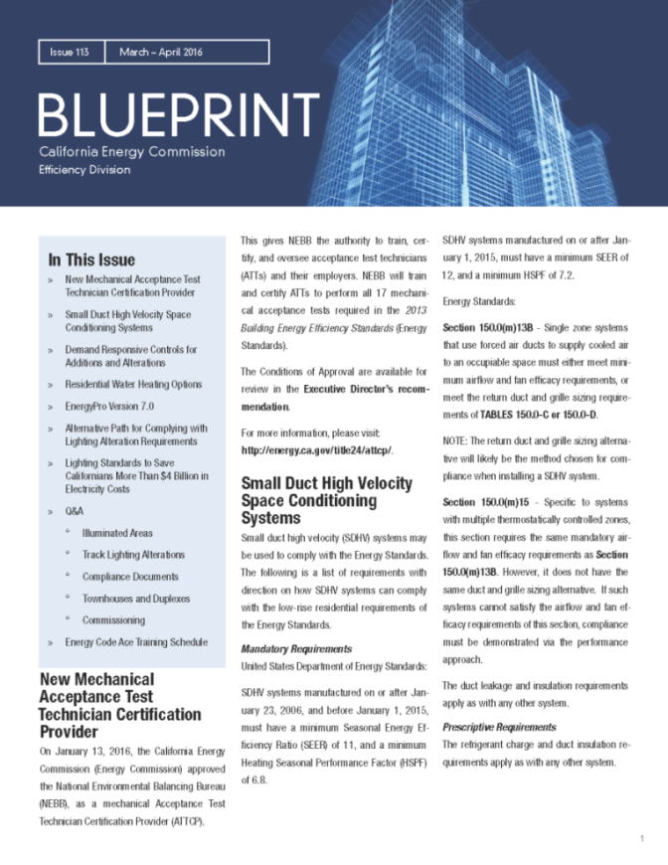
Blueprint Newsletter
Email Newsletter
Published Quarterly
Updates on Energy Standards Related Information
Clarifications on frequently asked questions.

Slide 7
Energy Standards Hotline
Open Monday through Friday
  8:00 a.m. to 12:00 p.m. and 1:00 p.m. to 4:30 p.m.
Call
  800-772-3300 (in CA)
  916-654-5106 (outside CA)
Email
  title24@energy.ca.gov

Slide 8
Email List Server Subscriptions
Receive Updates on the Energy Standards
Sign up:
  www.energy.ca.gov/listservers/
Subscribe to the following lists:
  Building Standards
  Blueprint
Respond to confirmation email within 24 hours

